Slide 1

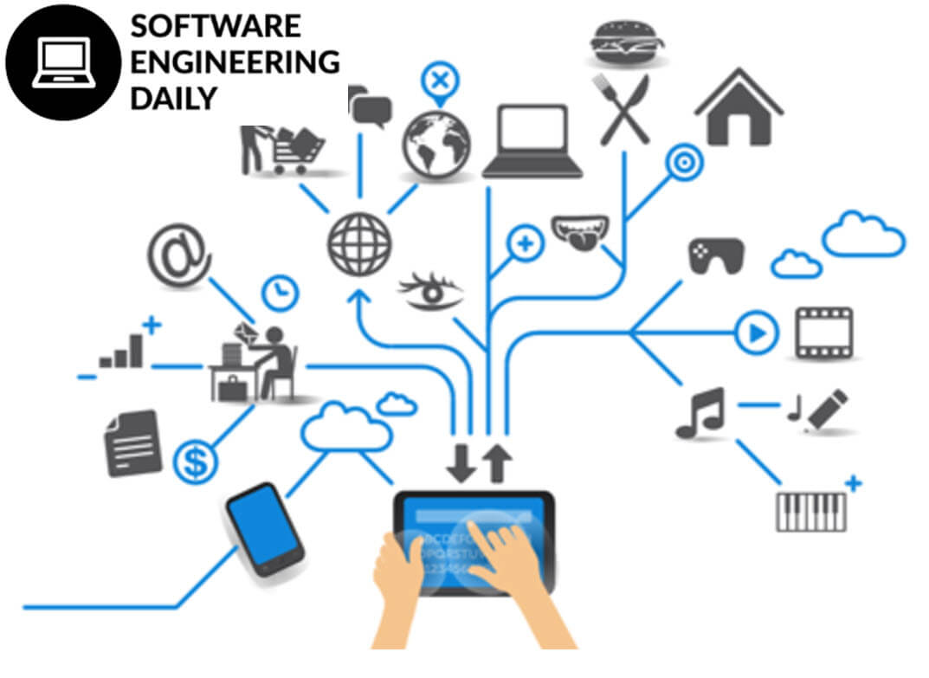
Defining an IT Project
Prepared by:
MR. CELSO T. AGOS JR.,MSIT
Microsoft Certified Educator
Six Sigma Certified
Science and Technological Specialist
Doctor in Information Technology- on going

Slide 2

Project Scope
The project's scope is the work to be completed. A specific section of the project charter should clarify not only what will be produced or delivered by the project team, but also what will not be part of the project's scope. This distinction is important for two reasons. First,
Prepared by:
MR. CELSO T. AGOS JR.,MSIT
Microsoft Certified Educator
Six Sigma Certified
Science and Technological Specialist
Doctor in Information Technology- on going

Slide 3
Project Scope
it provides the foundation for developing the project plan's schedule and cost estimates. Changes to the project's scope will impact the project's schedule and budget—that is, if resources are fixed, expanding the amount work you have to complete will take more time and money. Therefore, the creation of additional work for the project team will extend the project's schedule and invariably increase the cost
Prepared by:
MR. CELSO T. AGOS JR.,MSIT
Microsoft Certified Educator
Six Sigma Certified
Science and Technological Specialist
Doctor in Information Technology- on going

Slide 4
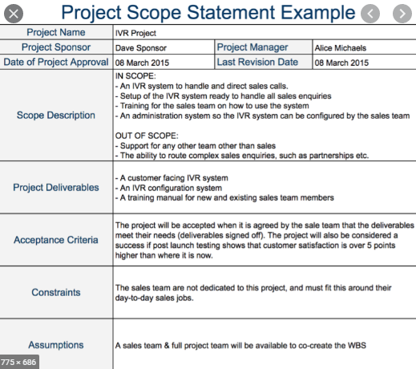
Prepared by:
MR. CELSO T. AGOS JR.,MSIT
Microsoft Certified Educator
Six Sigma Certified
Science and Technological Specialist
Doctor in Information Technology- on going

Slide 5
Work Breakdown Structure
A work breakdown structure (WBS) is discussed first. It provides a hierarchical structure that outlines the activities or work that needs to be done in order to complete the project scope. The WBS also provides a bridge or link between the project's scope and the detailed project plan that will be entered into a project management software package.
Prepared by:
MR. CELSO T. AGOS JR.,MSIT
Microsoft Certified Educator
Six Sigma Certified
Science and Technological Specialist
Doctor in Information Technology- on going

Slide 6
Today, most project management software packages are relatively inexpensive and rich in features. It is almost unthinkable that anyone would plan and manage a project without such a tool. Project success, however, will not be determined by one's familiarity with a project management software package or the ability to produce nice THE WORK BREAKDOWN STRUCTURE (WBS) 123 looking reports and graphs.
Prepared by:
MR. CELSO T. AGOS JR.,MSIT
Microsoft Certified Educator
Six Sigma Certified
Science and Technological Specialist
Doctor in Information Technology- on going

Slide 7
It is the thought process that must be followed before using the tool that counts! Thinking carefully through the activities and their estimated durations first will make the use of a project management software package much more effective. You can still create nice looking reports and graphs, but you'll have more confidence in what those reports and graphs say
Prepared by:
MR. CELSO T. AGOS JR.,MSIT
Microsoft Certified Educator
Six Sigma Certified
Science and Technological Specialist
Doctor in Information Technology- on going

Slide 8
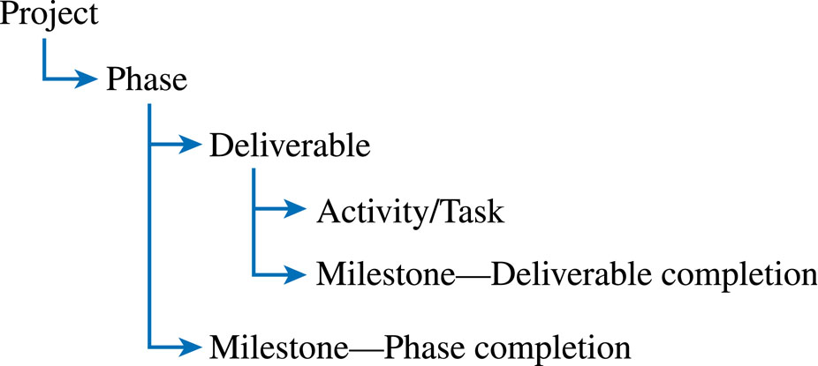
Prepared by:
MR. CELSO T. AGOS JR.,MSIT
Microsoft Certified Educator
Six Sigma Certified
Science and Technological Specialist
Doctor in Information Technology- on going

Slide 9
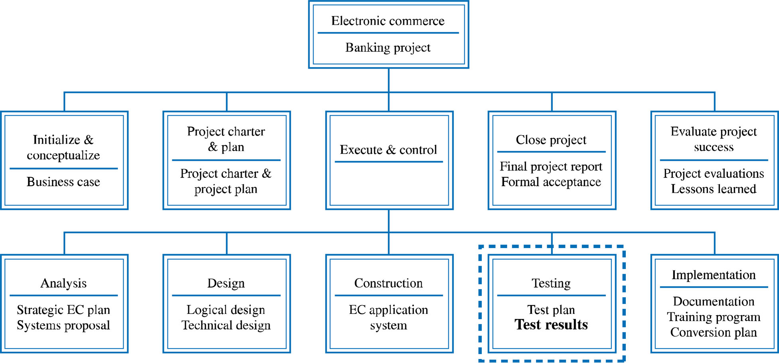
Prepared by:
MR. CELSO T. AGOS JR.,MSIT
Microsoft Certified Educator
Six Sigma Certified
Science and Technological Specialist
Doctor in Information Technology- on going

Slide 10
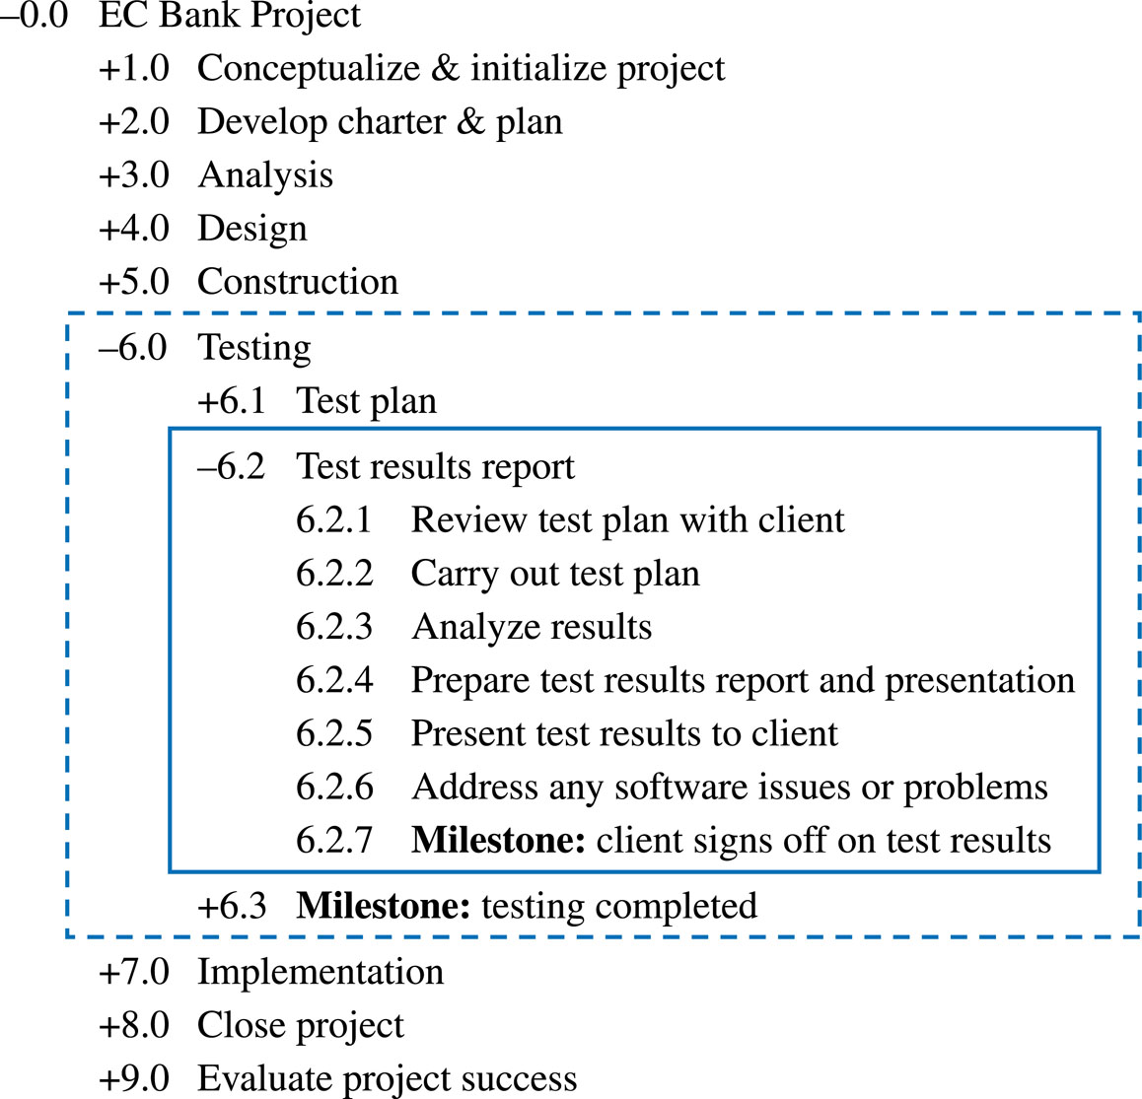
Example Work Breakdown Schedule
Prepared by:
MR. CELSO T. AGOS JR.,MSIT
Microsoft Certified Educator
Six Sigma Certified
Science and Technological Specialist
Doctor in Information Technology- on going

Slide 11
The WBS…
Should be “deliverable-oriented”
Should support the project’s MOV
Have enough detail to support planning and control
Should involve those who will be doing the work
Should include learning cycles and past lessons learned
Prepared by:
MR. CELSO T. AGOS JR.,MSIT
Microsoft Certified Educator
Six Sigma Certified
Science and Technological Specialist
Doctor in Information Technology- on going

Slide 12
Estimation Questions
What are you going to estimate?
Where do you start?
How do you estimate?
Prepared by:
MR. CELSO T. AGOS JR.,MSIT
Microsoft Certified Educator
Six Sigma Certified
Science and Technological Specialist
Doctor in Information Technology- on going

Slide 13
Estimation Techniques - Traditional Project Management Approaches
Guesstimating
Delphi Technique
Time Boxing
Top-Down
Bottom-Up
Analogous Estimates (Past experiences)
Parametric Modeling (Statistical)
Prepared by:
MR. CELSO T. AGOS JR.,MSIT
Microsoft Certified Educator
Six Sigma Certified
Science and Technological Specialist
Doctor in Information Technology- on going

Slide 14
Guestimating
Estimation by guessing or just picking numbers out of the air is not the best way to derive a project’s schedule and budget. Unfortunately, many inexperienced project managers tend to guesstimate, or guess at the estimates, because it is quick and easy.
Prepared by:
MR. CELSO T. AGOS JR.,MSIT
Microsoft Certified Educator
Six Sigma Certified
Science and Technological Specialist
Doctor in Information Technology- on going

Slide 15
Delphi Technique
Involves multiple, anonymous experts
Each expert makes an estimate
Estimates compared
If close, can be averaged
If not, do another iteration until consensus is reached
Prepared by:
MR. CELSO T. AGOS JR.,MSIT
Microsoft Certified Educator
Six Sigma Certified
Science and Technological Specialist
Doctor in Information Technology- on going

Slide 16
Time Boxing
A “box” of time is allocated for a specific activity, task, or deliverable
Can focus a team if used effectively
Can demoralize a team if not used effectively
Prepared by:
MR. CELSO T. AGOS JR.,MSIT
Microsoft Certified Educator
Six Sigma Certified
Science and Technological Specialist
Doctor in Information Technology- on going

Slide 17
Top-Down
Top & middle managers determine overall project schedule &/or cost
Lower level managers are expected to breakdown schedule/budget estimates into specific activities (WBS)
Prepared by:
MR. CELSO T. AGOS JR.,MSIT
Microsoft Certified Educator
Six Sigma Certified
Science and Technological Specialist
Doctor in Information Technology- on going

Slide 18
Bottom-Up
Schedules & budgets are constructed from WBS
Starts with people who will be doing the work
Schedules & budgets are the aggregate of detailed activities & costs
Prepared by:
MR. CELSO T. AGOS JR.,MSIT
Microsoft Certified Educator
Six Sigma Certified
Science and Technological Specialist
Doctor in Information Technology- on going

Slide 19
Analogous Estimates
Similar to Top-Down approach
Use information from previous, similar projects as a basis for estimation
Parametric Modeling
Use project characteristics (parameters) in a mathematical model to estimate
Example: $50/ LOC based on:
Programming language
Level of expertise
Size & complexity
Prepared by:
MR. CELSO T. AGOS JR.,MSIT
Microsoft Certified Educator
Six Sigma Certified
Science and Technological Specialist
Doctor in Information Technology- on going

Slide 20
References:
Information technology management book by jack t marchewka
Prepared by:
MR. CELSO T. AGOS JR.,MSIT
Microsoft Certified Educator
Six Sigma Certified
Science and Technological Specialist
Doctor in Information Technology- on going

